Slide 1

Tech Talk on Digital Transformation
Sathya Shanmugavelu

Slide 2

Artificial Intelligence

Slide 3
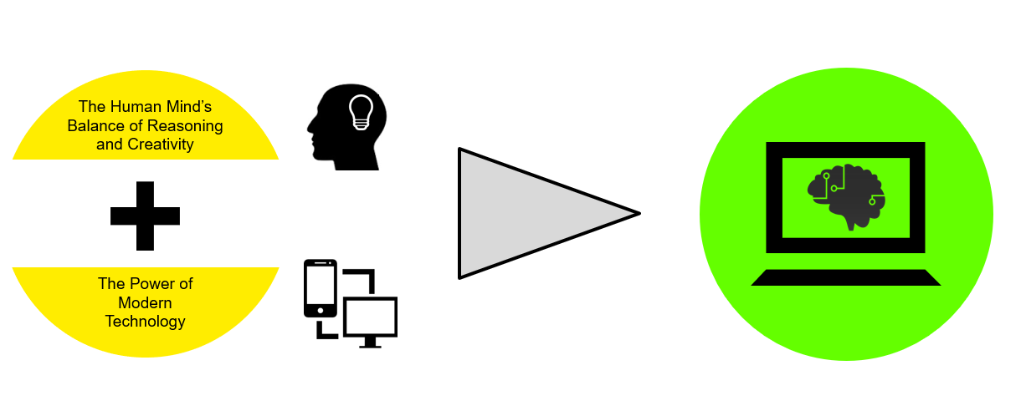
Cognitive Computing & AI

Slide 4
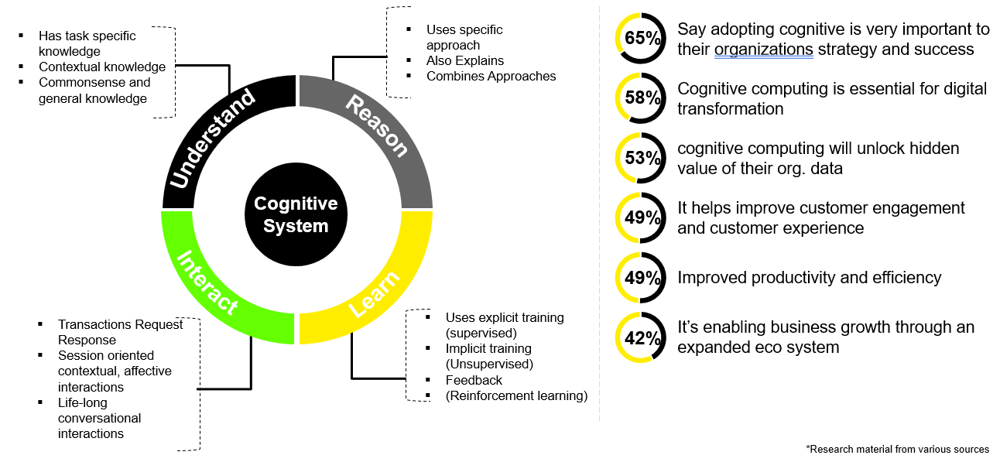

AI & Cognitive Computing Market

Slide 5
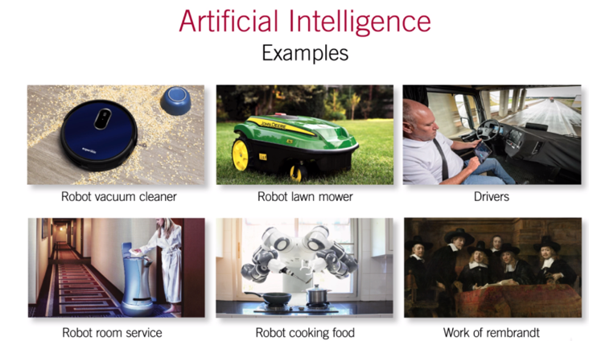

AI Automation

Slide 6
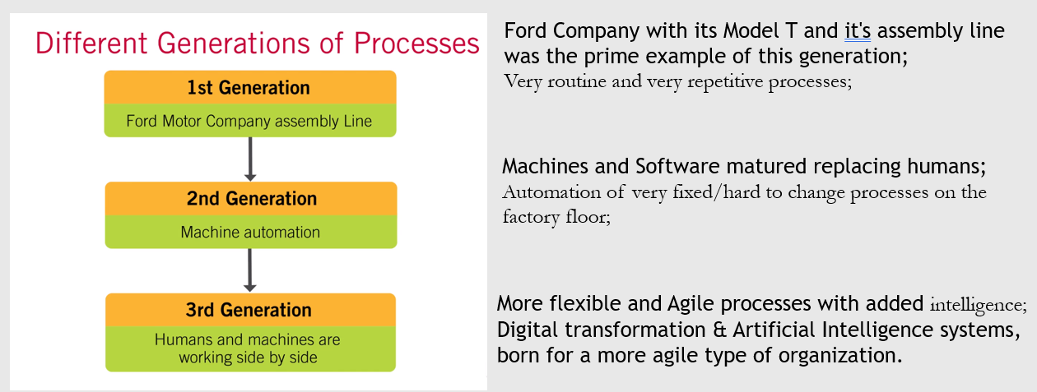

AI Augmentation

Slide 7
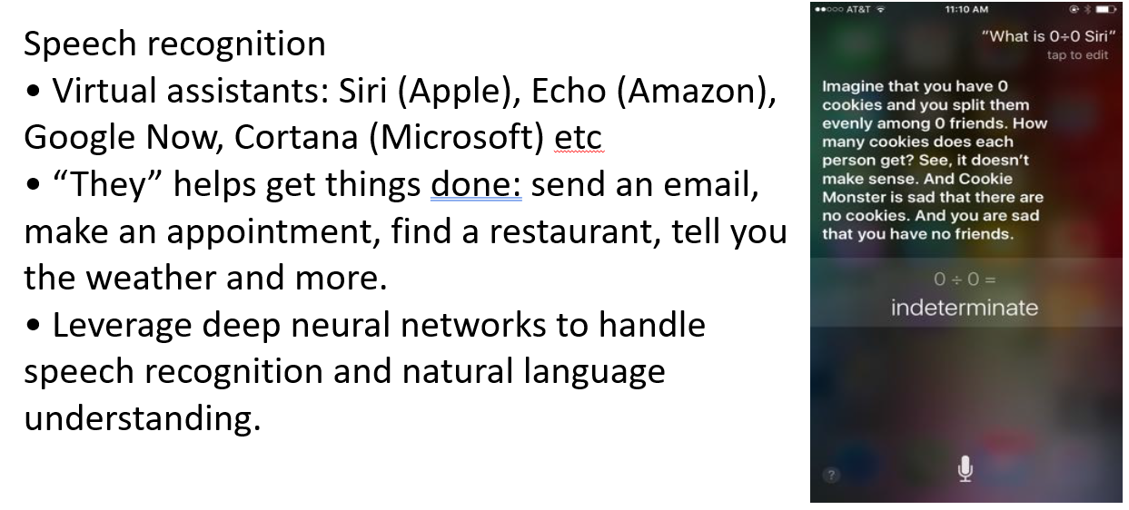
Real Life Applications of AI

Slide 8
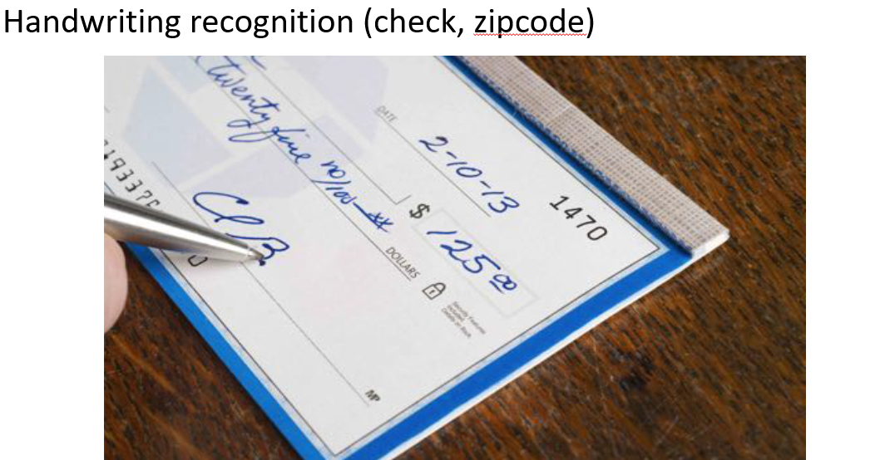
Real Life Applications of AI

Slide 9
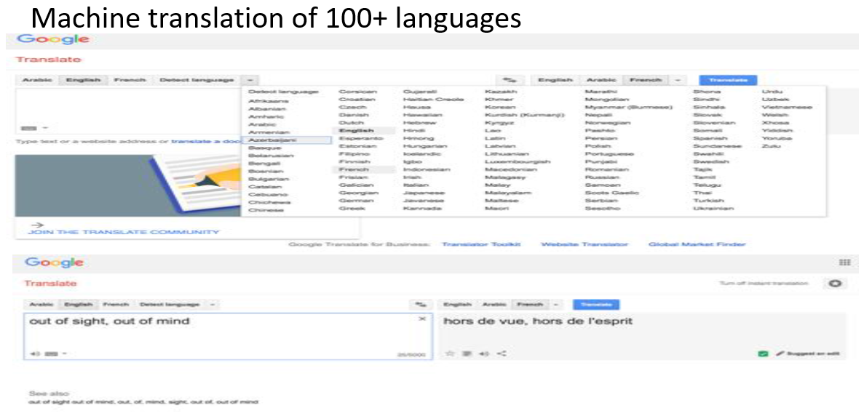
Real Life Applications of AI

Slide 10
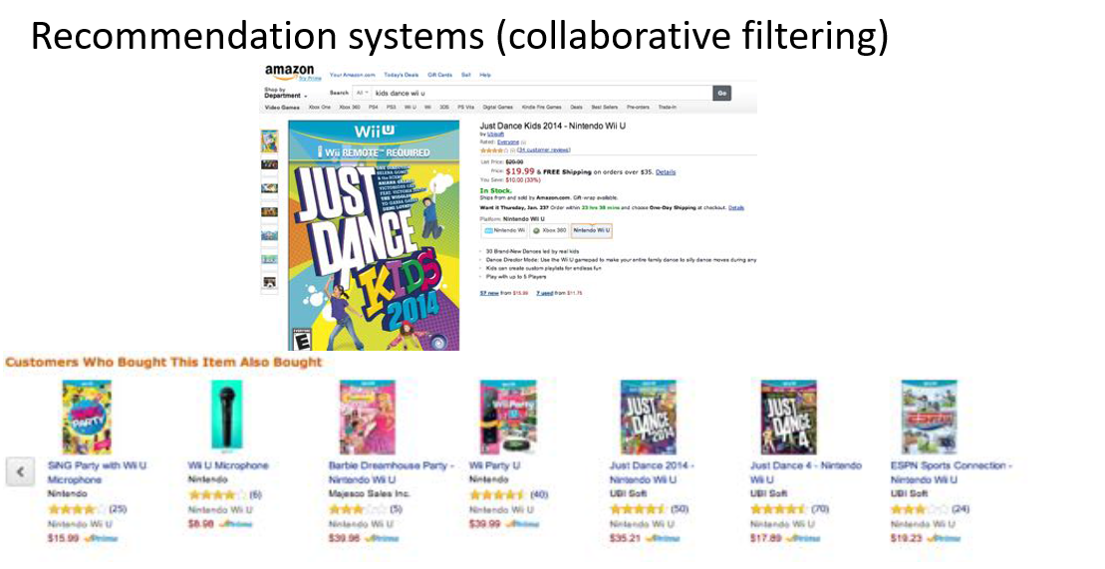
Real Life Applications of AI

Slide 11
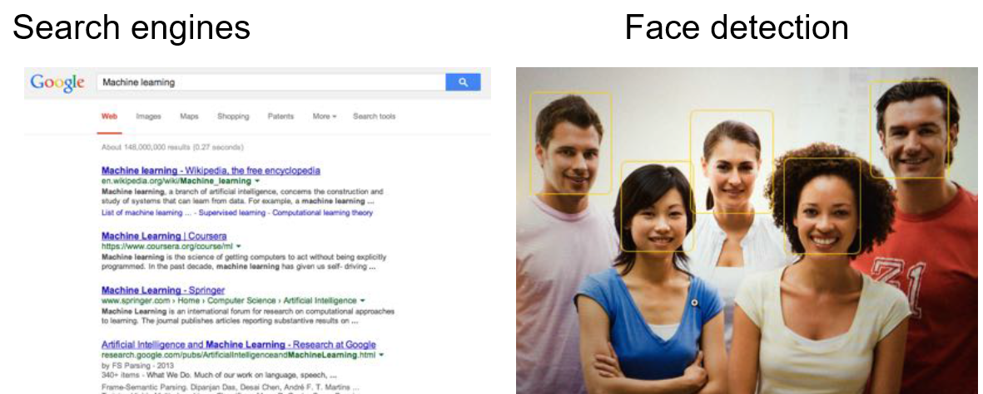
Real Life Applications of AI

Slide 12
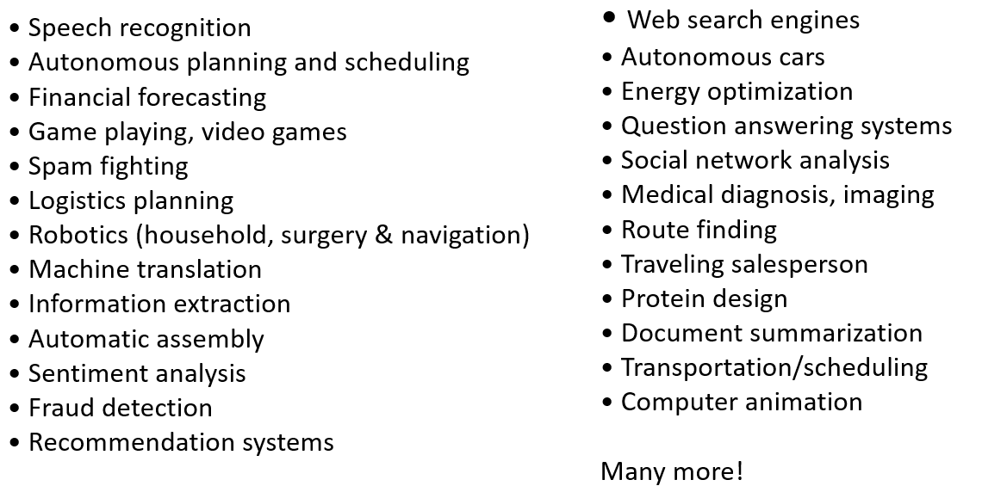
State of the Art Applications

Slide 13

Machine Learning & Deep Learning

Slide 14
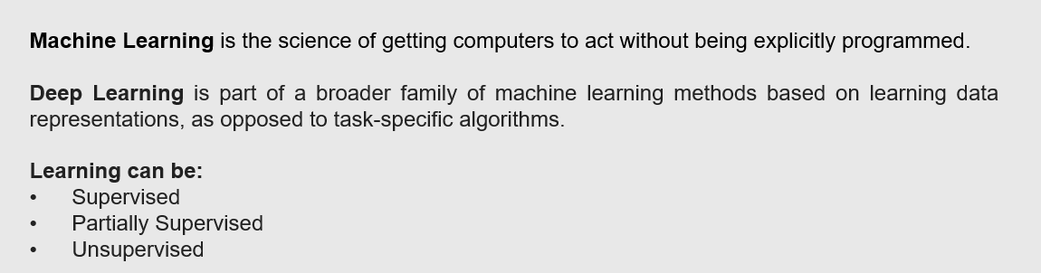
Machine Learning and Deep Learning

Slide 15
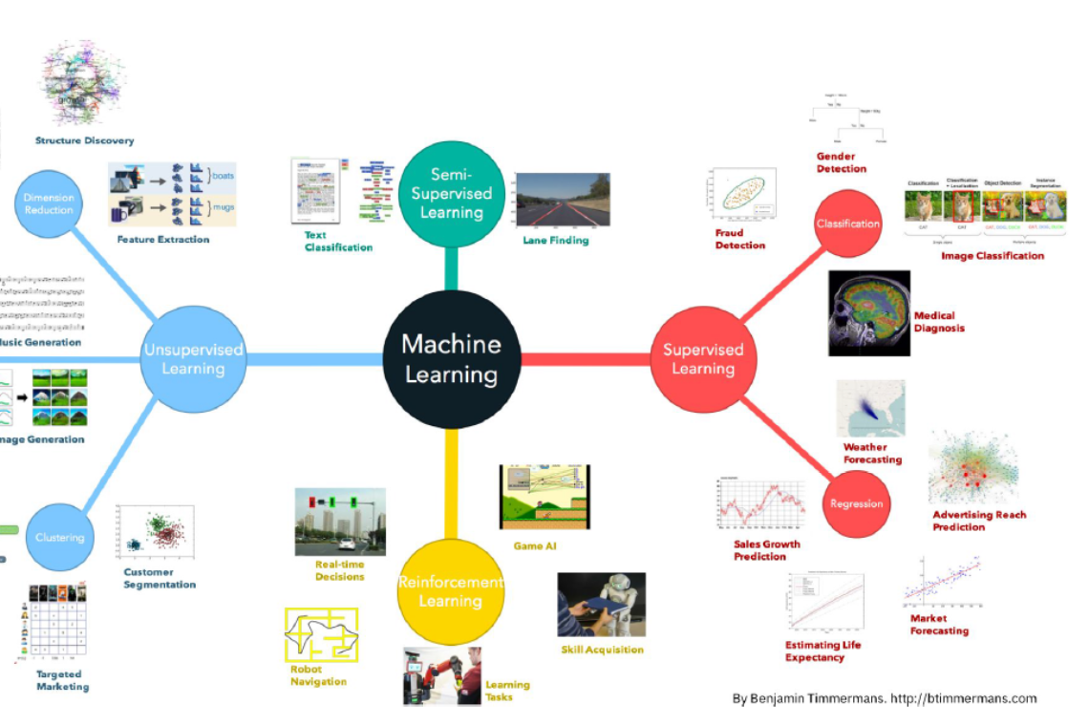

Types of Machine Learning

Slide 16
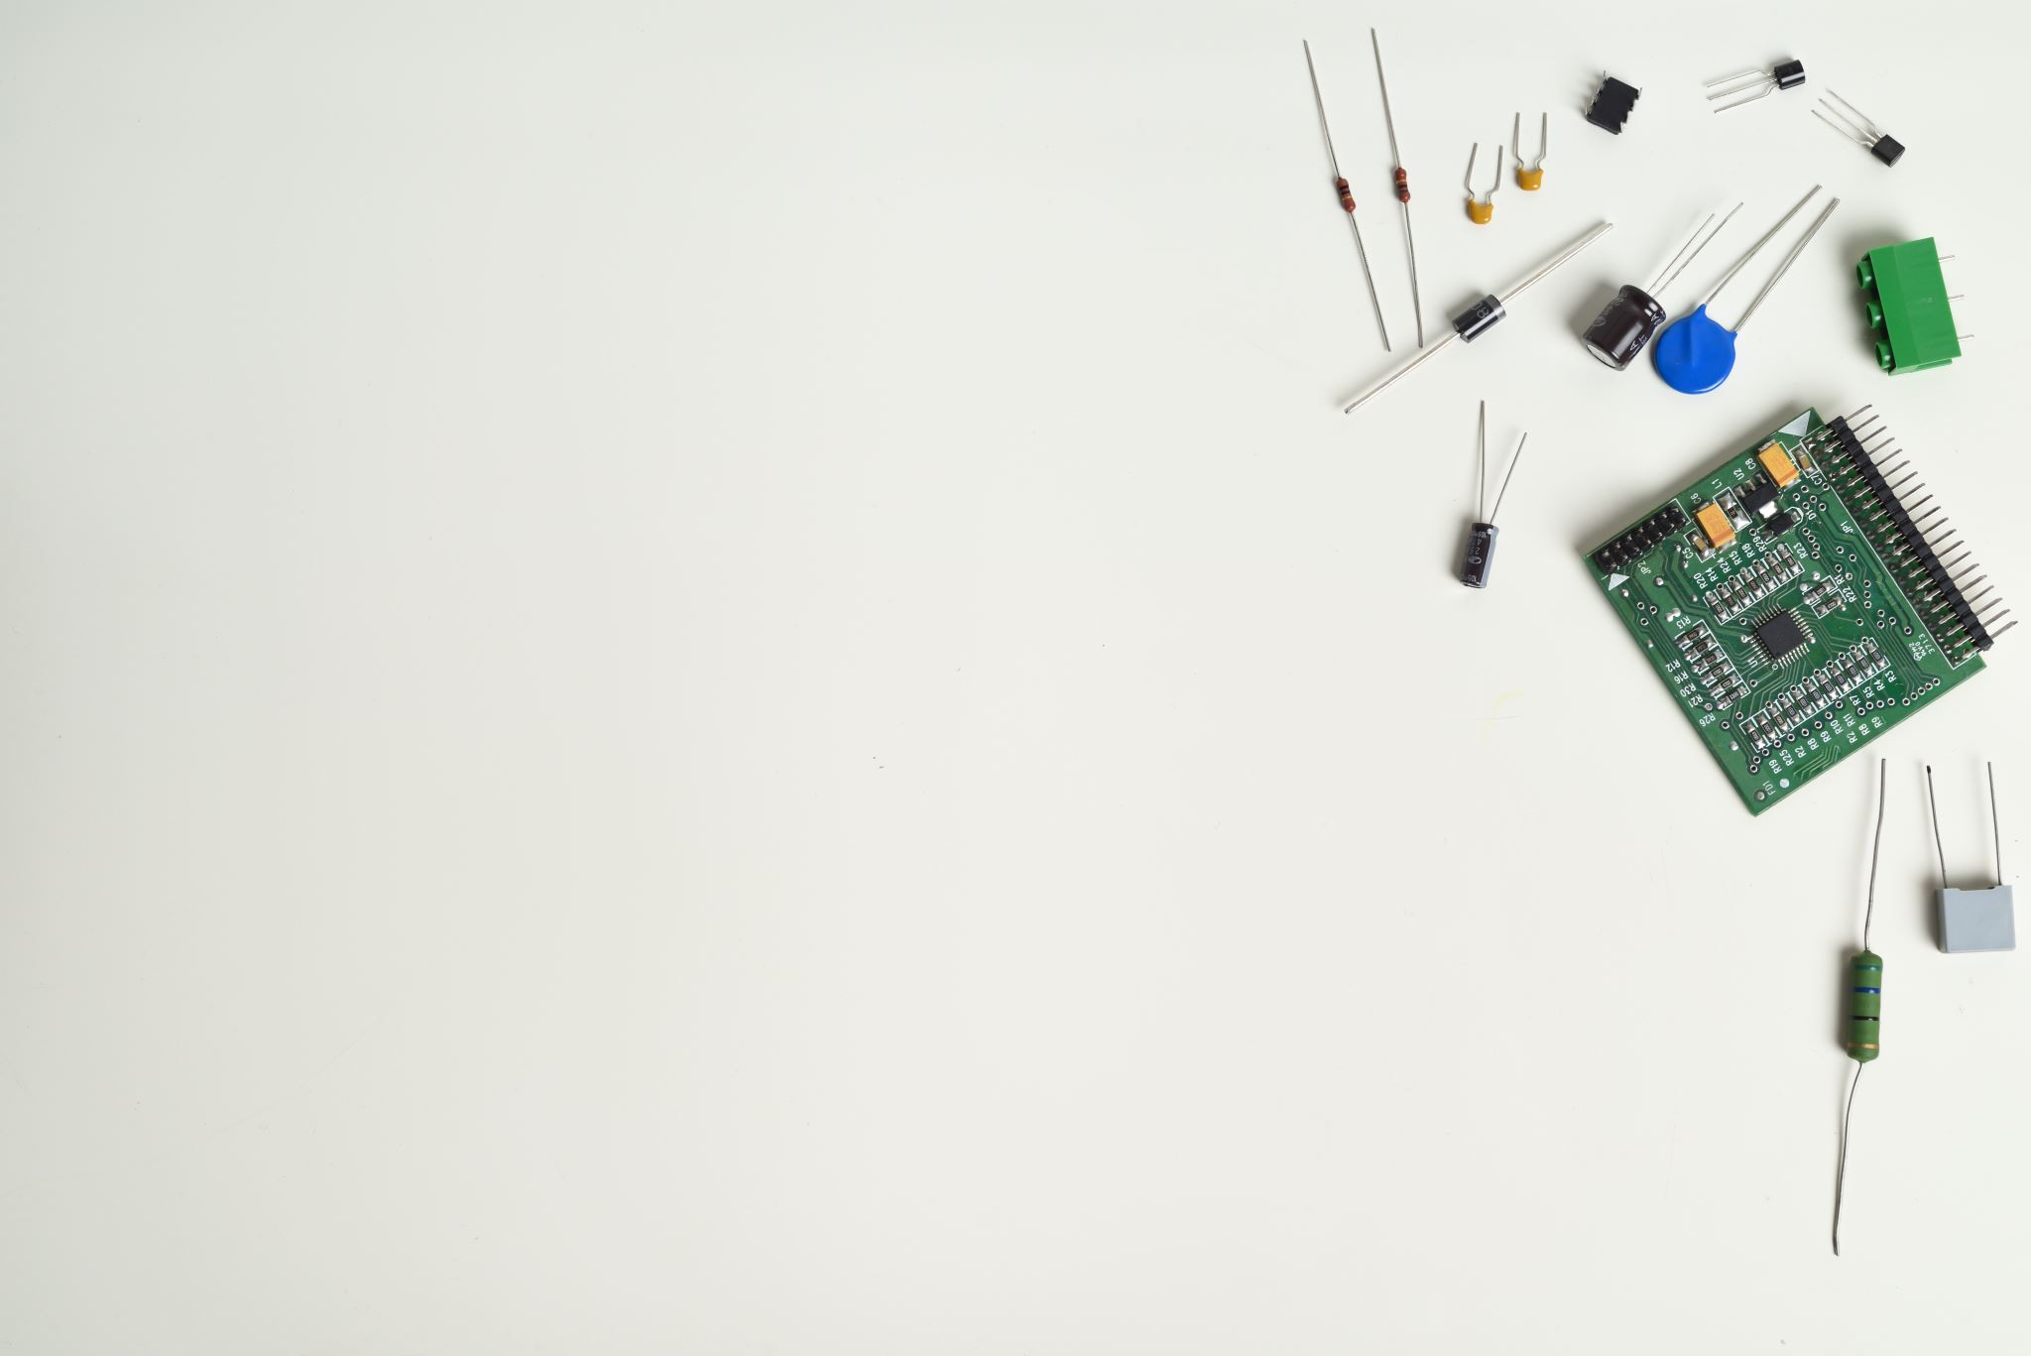
Internet of Things

Slide 17

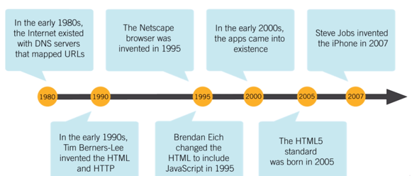
Evolution of Web

Slide 18
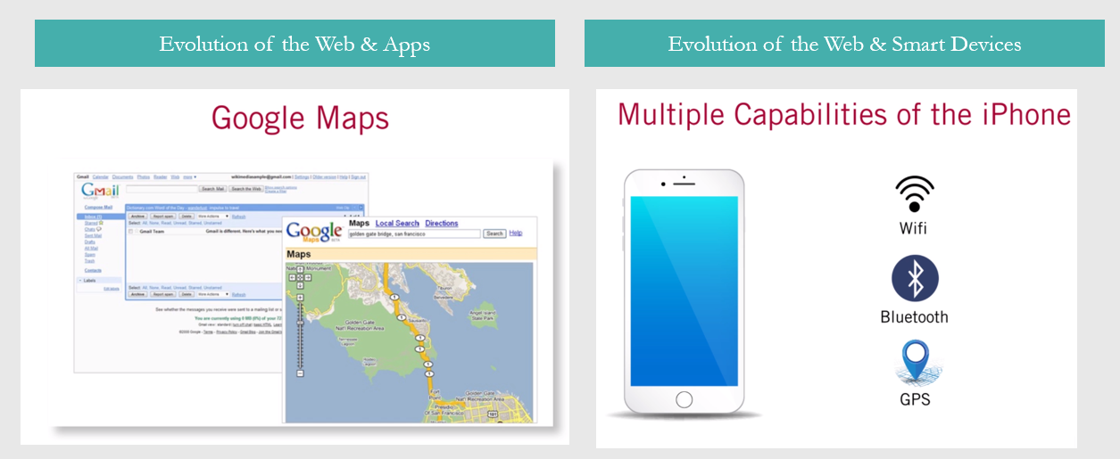

Introduction to IoT

Slide 19

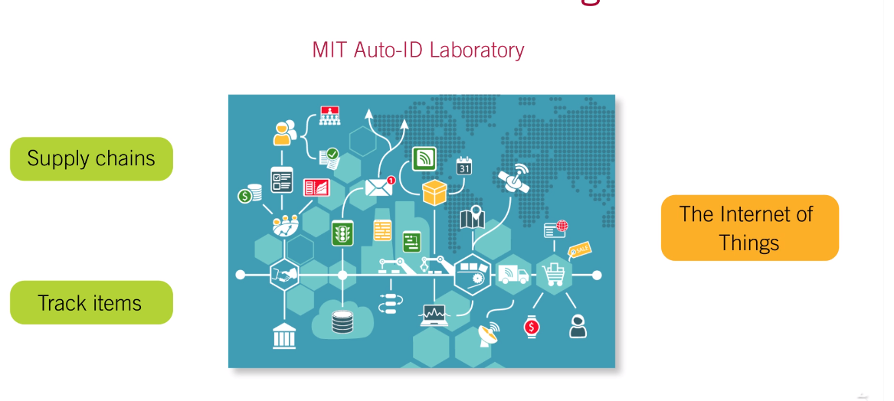
IoT Evolution from Supply Chain

Slide 20
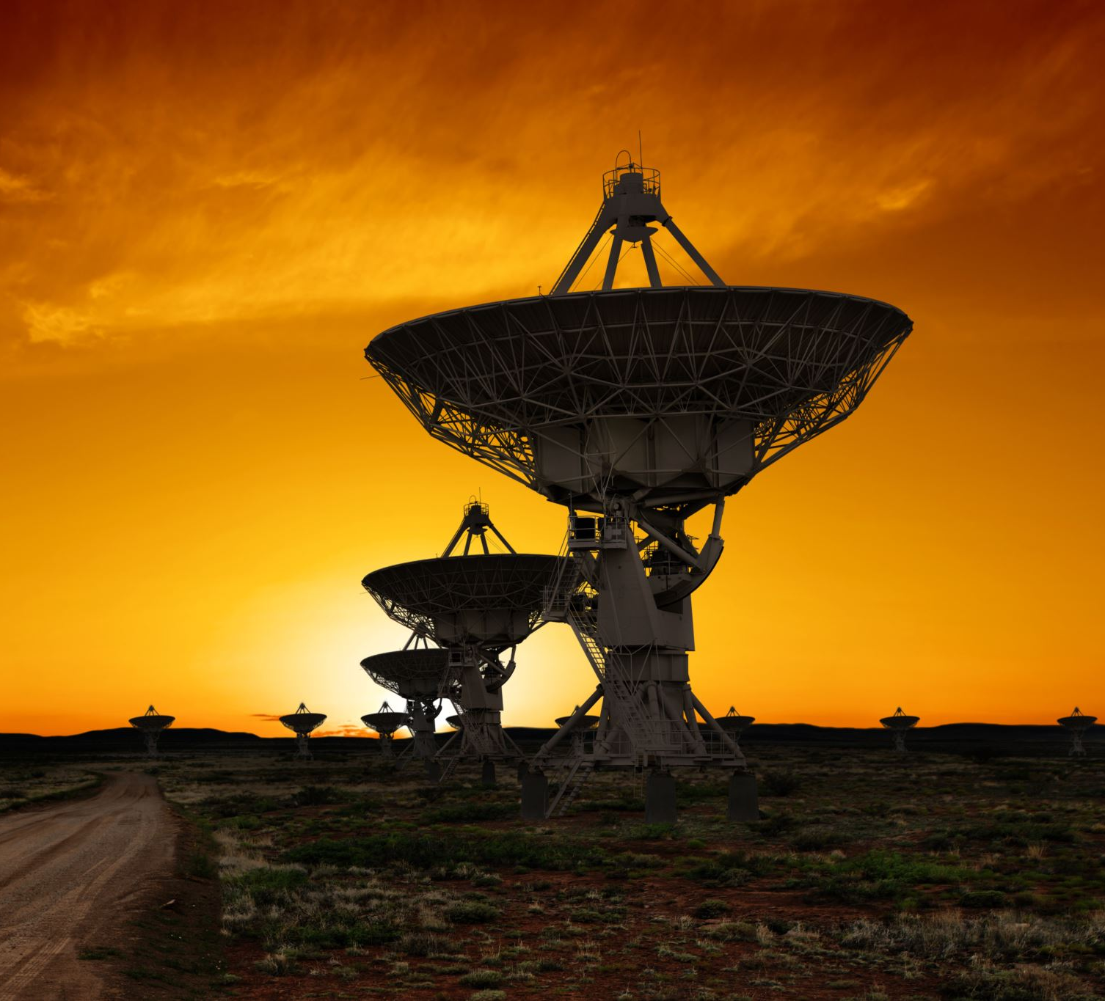
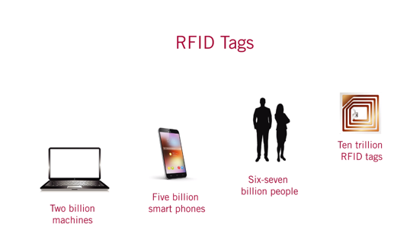
IoT Evolution from Supply Chain

Slide 21

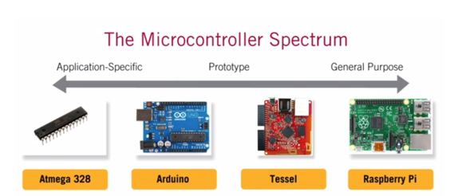
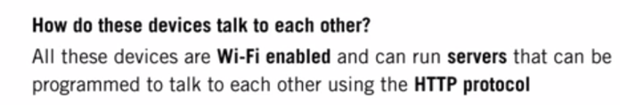
IoT Hardware

Slide 22
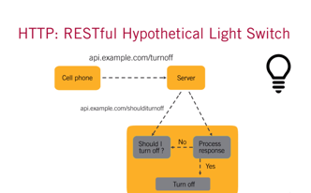
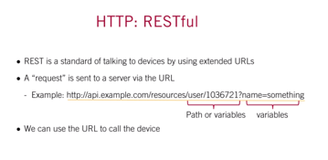
IoT Hardware Protocols

Slide 23
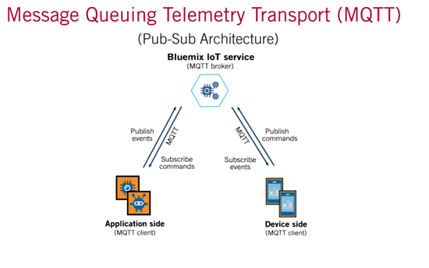
IoT Hardware Protocols

Slide 24
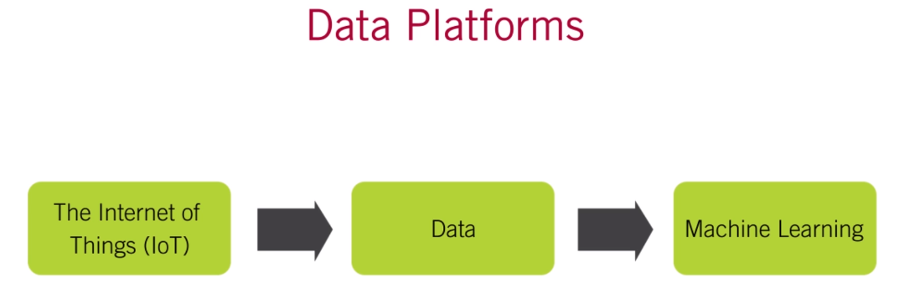

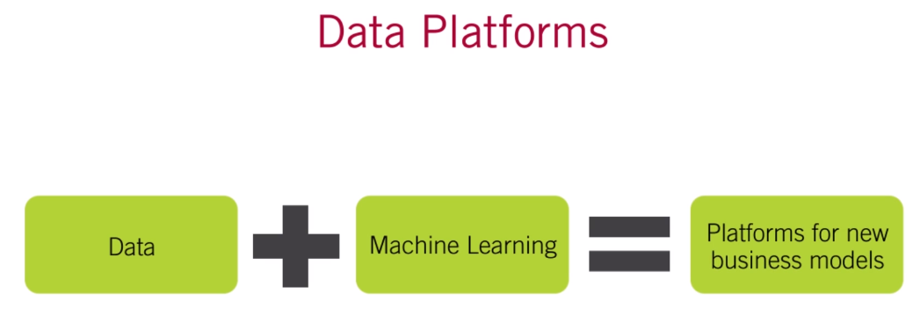
Evolution of Data Platforms

Slide 25
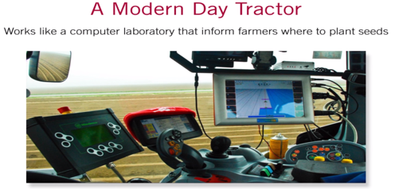
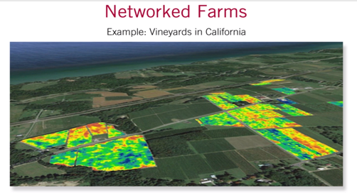
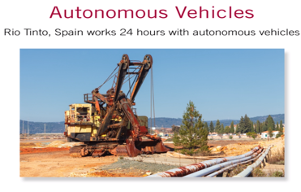

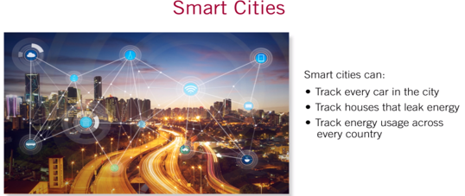
IoT Connected Intelligence

Slide 26
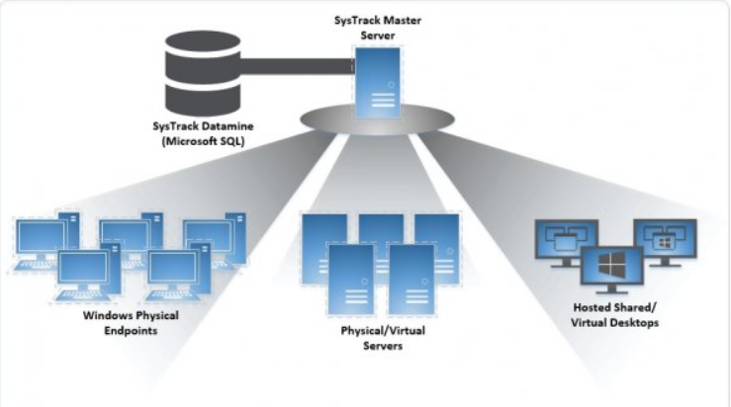
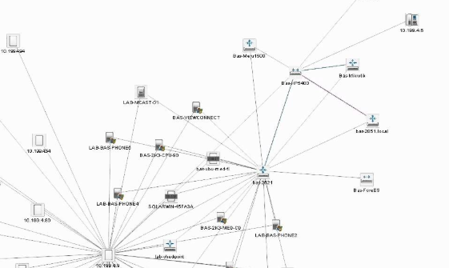
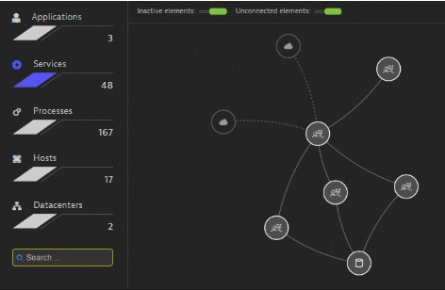

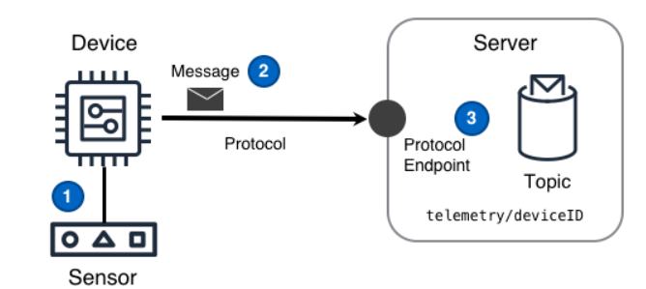
IoT Telemetry Applications

Slide 27

IoT Cybersecurity

Slide 28

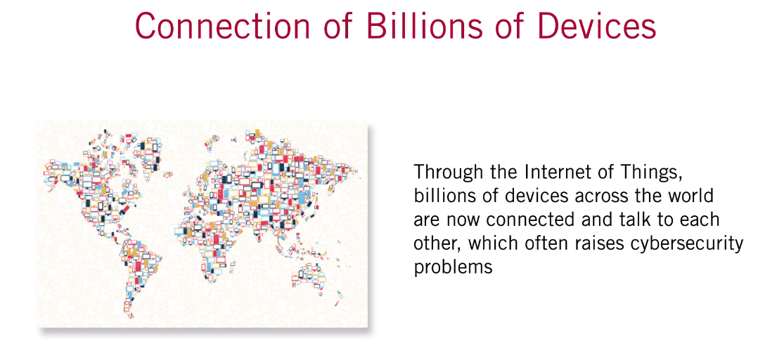
IoT and Cybersecurity

Slide 29
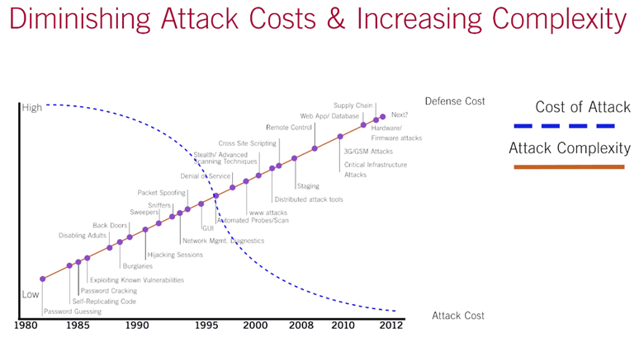
IoT and CyberSecurity

Slide 30
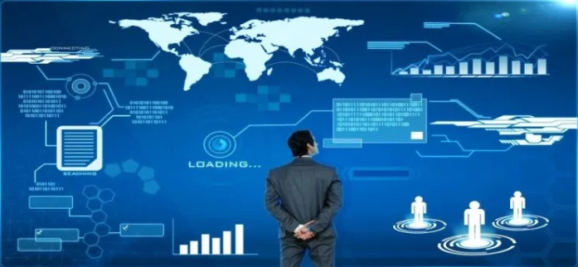
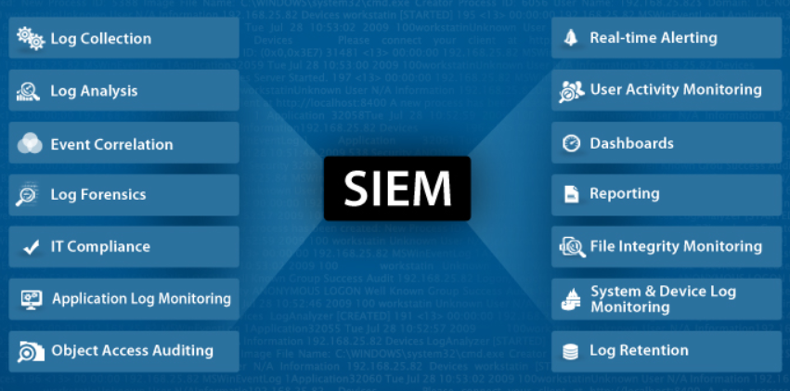
Security Information and Event Management

Slide 31

Cloud Computing Commons

Slide 32

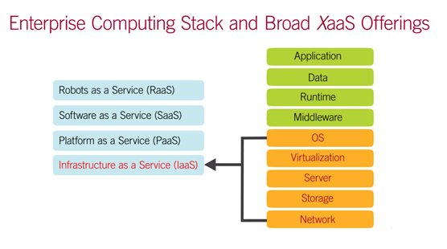
Cloud - Everything as a Service (XaaS)

Slide 33
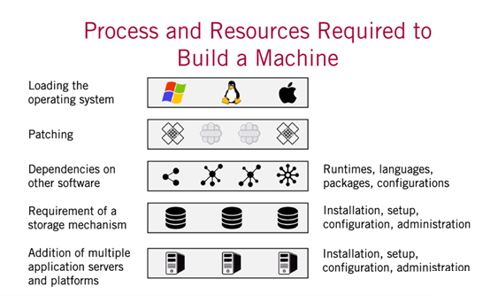
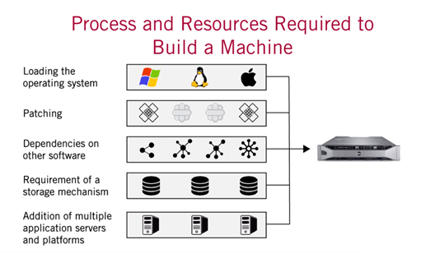

Cloud Scriptable Virtual Machine

Slide 34
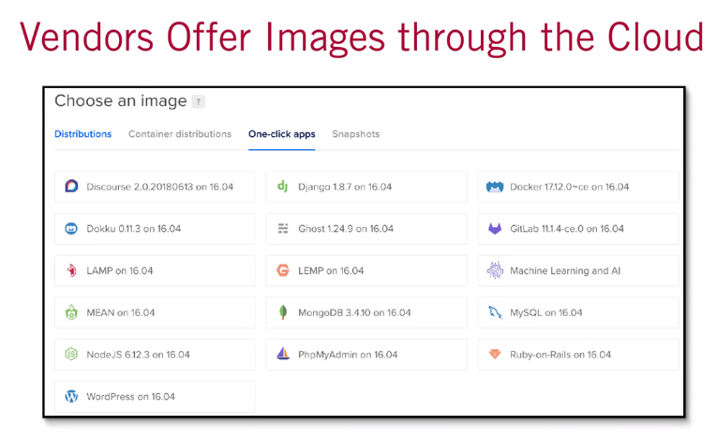
Cloud Scriptable Virtual Machine

Slide 35
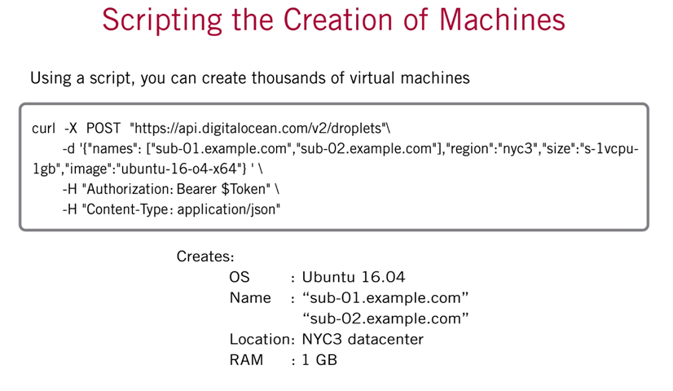
Cloud Scriptable Virtual Machine

Slide 36
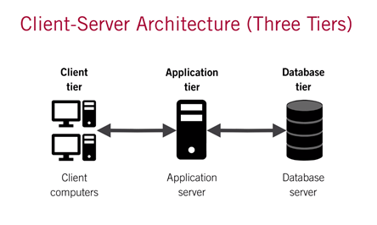

Traditional Delivery of Software Client Server

Slide 37
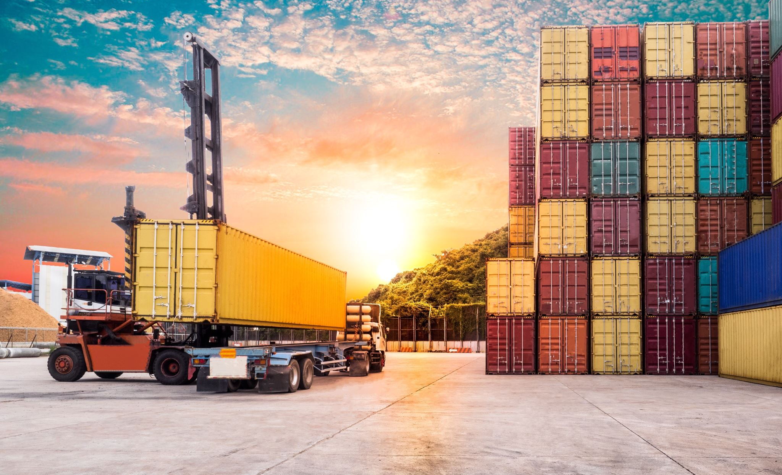
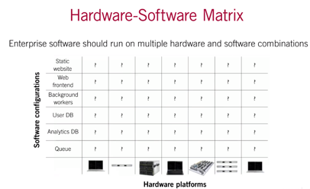
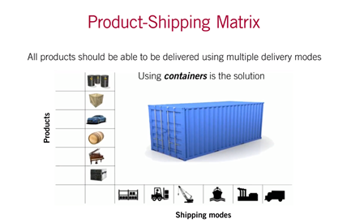
Cloud Containers

Slide 38
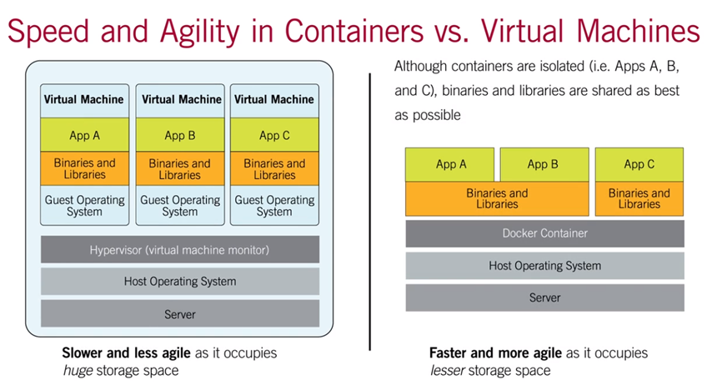
Cloud Containers – Speed and Agility

Slide 39
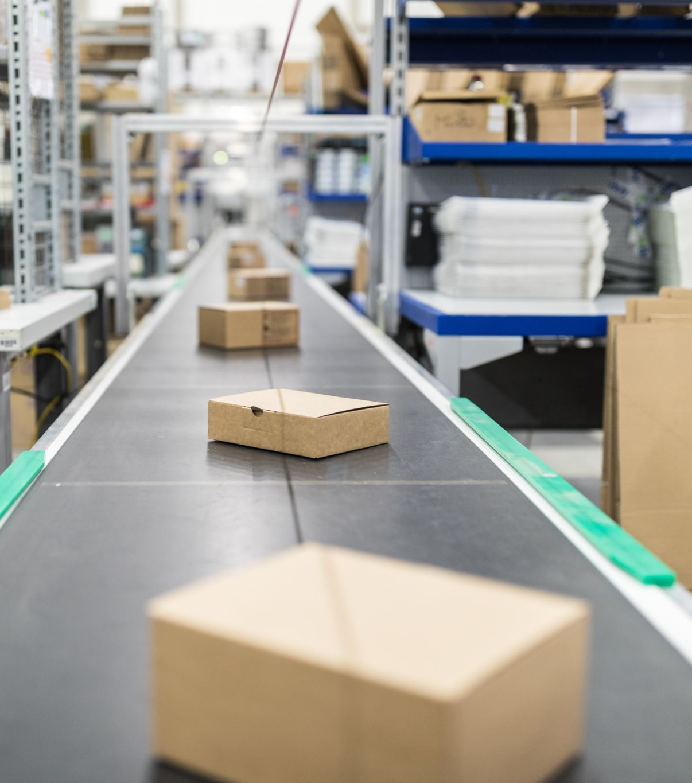
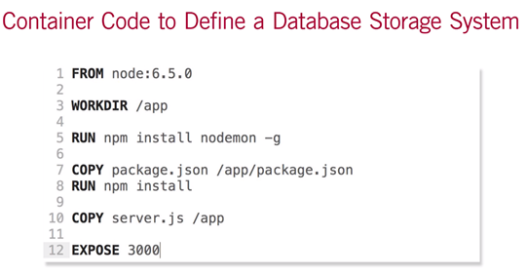
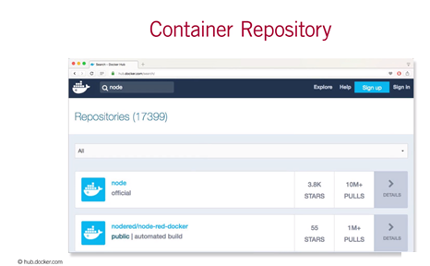
Docker Repository & Container Code

Slide 40

Serverless Serverless means that the cloud provider acts as the server & dynamically manages the allocation of machine resources

Slide 41

Example Serverless Model : AWS Lambda

Slide 42


Serverless Pricing

Slide 43



DevOps - Continuous Integration and Continuous Deployment

